Slide 1

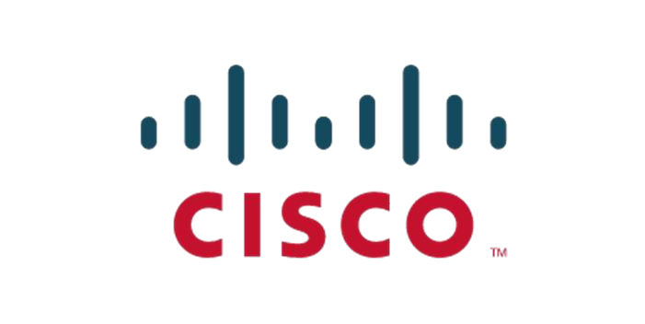

Lecture -Testing
Testing in Python
Dr. AALWAHAB DHULFIQAR ZOLTAN
What you will learn:
Testing
Unit Testing
Integration Testing
System Testing
Test coverage

Slide 2
Why do we need testing? Testing is a crucial part of software development for several key reasons:
1. Ensuring Software Quality
Verification of Functionality: Testing ensures that the software behaves as expected according to the specified requirements. It helps confirm that each feature works correctly, delivering the functionality users need.
Validation: Testing verifies that the software meets the user's needs and expectations. It ensures that the product being developed aligns with the intended use.
2. Identifying and Fixing Bugs
Early Detection of Defects: Testing allows developers to catch bugs and issues early in the development process before they reach production, where they could cause more significant problems.
Preventing Future Issues: By fixing bugs early, testing helps prevent related issues from arising later in the development cycle or in future updates.
3. Improving Software Reliability and Stability
Reliability: Well-tested software is more reliable. It’s less likely to crash, lose data, or behave unpredictably, leading to a better user experience. Stability: Regular testing, especially through practices like regression testing, ensures that new changes don’t inadvertently break existing functionality.

Slide 3
4. Enhancing Security
Identifying Vulnerabilities: Security testing identifies potential vulnerabilities that could be exploited by attackers. This is critical for protecting sensitive data and maintaining user trust.
Compliance: Many industries require software to meet specific security standards or regulatory requirements, which testing helps ensure.
5. Cost-Effective Development
Reducing Maintenance Costs: Bugs found later in the development process or after release are typically more expensive to fix. Testing early and often helps reduce the overall cost of development by minimizing these expensive post-release fixes.
Avoiding Rework: Continuous testing throughout the development process reduces the need for rework, helping keep projects on time and within budget.
7. Improving User Experience
Usability: Testing ensures that the software is user-friendly and meets the needs of its intended audience. Usability testing focuses specifically on the user experience, ensuring that the interface is intuitive and efficient.
Performance: Performance testing helps ensure that the software performs well under expected (and unexpected) loads, providing a smooth experience for all users.

Slide 4
Why Python for testing?
Python is a popular choice for testing in software development for several compelling reasons:
1. Readability and Simplicity:
Clear Syntax: Python's clean and readable syntax makes it easy to write, understand, and maintain test scripts. This is particularly important in testing, where clarity and precision are crucial.
Minimal Boilerplate: Python requires less boilerplate code compared to other languages, allowing testers to focus more on the logic of the tests rather than on the syntax.
2. Rich Ecosystem of Testing Frameworks:
unittest: Python comes with a built-in testing framework called unittest, which is modeled after Java’s JUnit and is widely used for writing and running tests.
pytest: A powerful and flexible testing framework that supports fixtures, parameterized tests, and a rich plugin architecture. It’s highly popular for both small and complex testing needs.
nose/nose2: A testing framework that extends unittest to make testing easier, with additional features like automatic test discovery.
doctest: Allows you to write tests as part of your documentation, making it easy to ensure that code examples in your docs remain accurate and functional.

Slide 5
Support for Various Testing Needs:
Unit Testing: Python’s frameworks like unittest and pytest are excellent for writing and running unit tests, allowing developers to test individual units of code.
Integration Testing: Python can easily handle integration tests, especially when combined with tools like requests for testing APIs or Selenium for web applications.
Functional and System Testing: Tools like Robot Framework and Behave (for BDD) make Python a strong choice for functional and system testing, supporting complex scenarios and user stories.
Performance Testing: Libraries like locust and pytest-benchmark make it possible to conduct performance testing within Python, assessing how the system behaves under load.
Security Testing: Python has libraries like bandit and Pytest plugins for security testing, making it easier to integrate security checks into the testing process.

Slide 6
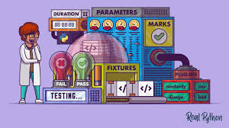
Getting Started With Testing in Python
Testing is the process of evaluating and verifying that a software system or application meets its specified requirements and works as intended. It involves executing the software with various inputs and scenarios to identify defects, errors, or issues that need to be addressed before the software is released or deployed.
Testing is crucial in software development because it helps ensure the quality, reliability, and correctness of the software. It also helps to identify and fix issues early in the development cycle, which can save time and resources in the long run.

Slide 7
What are Test Cases ?
Test cases in unit testing are like mini tests for your code. They check individual parts of your code (like functions) to make sure they work as expected with different inputs. This helps catch bugs early and keep your code reliable and working smoothly.
Types of test cases in unit testing :
Positive Test Cases
Purpose: Verify that your code functions as expected when provided with valid inputs.
Focus: These tests aim to confirm that the code produces the correct output or exhibits the desired behavior with typical, correct data.
Negative Test Cases
Purpose: Test how your code handles invalid inputs or unexpected scenarios. The goal is to ensure the code responds gracefully and produces appropriate error messages or exceptions.
Focus: These tests deliberately try to break your code (in a controlled way). They cover edge cases, boundary values, and incorrect data types.

Slide 8
Positive and negative test cases work hand-in-hand to provide a comprehensive testing strategy.Positive test cases ensure the core functionality of your code works under normal conditions and negative test cases protect your code against potential errors, making your application more robust and resilient to unexpected user input or edge cases.
Test suite: A collection of test cases, test suites, or both. They’re grouped and executed as a whole.
Test fixture: A group of actions required to set up an environment for testing. It also includes the teardown processes after the tests run.
Test runner: A component that handles the execution of tests and communicates the results to the user.

Slide 9
Types of Testing in Python
In the context of Python, testing refers to the process of writing and executing tests for Python code. Python provides several built-in modules and third-party libraries to facilitate testing. Here are some common testing approaches and tools in Python:
Unit testing
unittest
pytest
doctest
Test Coverage
Integration Testing
Functional Testing
Testing is an essential practice in software development, and Python provides various tools and frameworks to make testing easier and more effective. By writing tests, you can catch bugs early, ensure code quality, and facilitate refactoring and maintenance of your codebase.

Slide 10
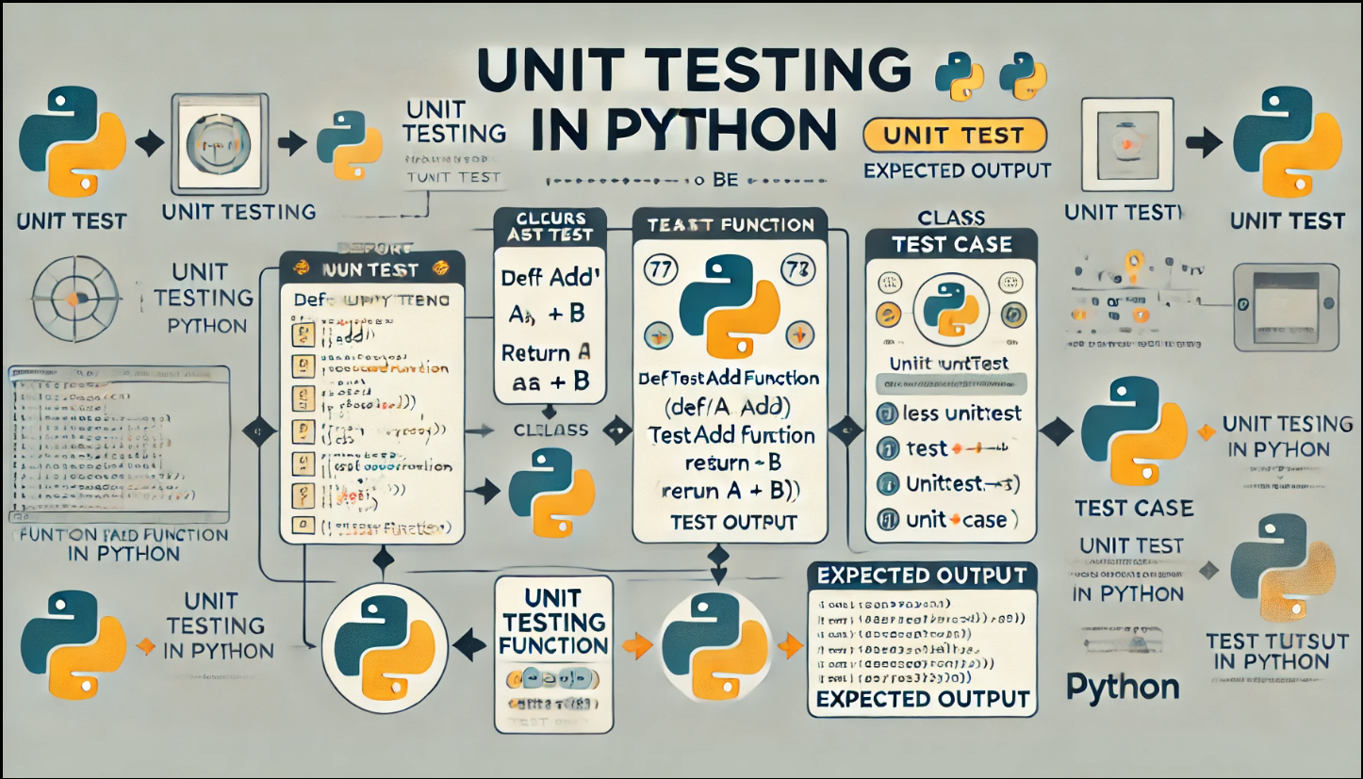
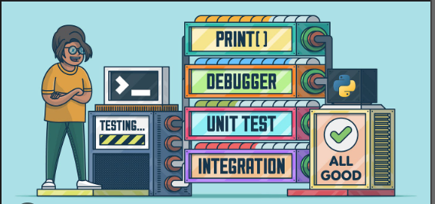
Unit testing
Unit Testing is a technique in which particular module is tested to check by developer himself whether there are any errors. The primary focus of unit testing is test an individual unit of system to analyze, detect, and fix the errors.
Python provides several frameworks for unit testing, with the most common being unittest, pytest, and doctest

Slide 11
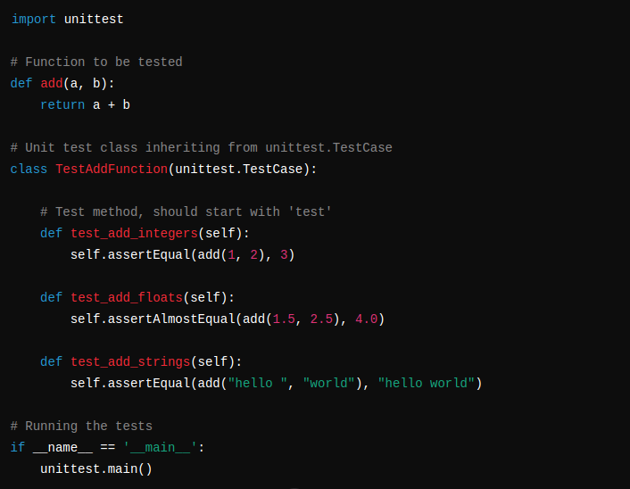
unittest
unittest is the built-in testing framework in Python and is inspired by Java's JUnit. It supports test automation, sharing of setup and shutdown code for tests, aggregation of tests into collections, and independence of the tests from the reporting framework.
The unittest package defines the TestCase class, which is primarily designed for writing unit tests. To start writing your test cases, you just need to import the class and subclass it. Then, you’ll add methods whose names should begin with test. These methods will test a given unit of code using different inputs and check for the expected results.

Slide 12
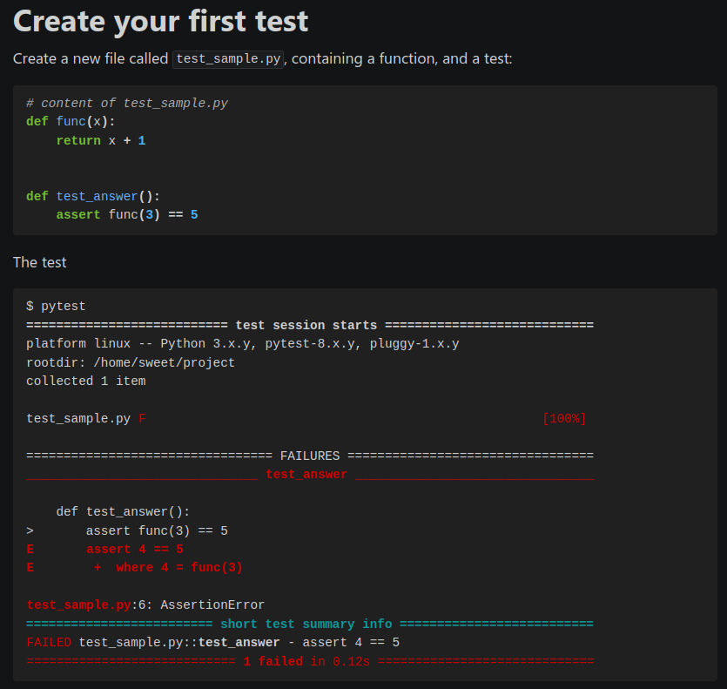
pytest
pytest is a more powerful and flexible testing framework that is often preferred over unittest for its simplicity and advanced features like fixtures, parameterized tests, and better output formatting.
pytest requires: Python 3.8+ or PyPy3.In order to run the pytest first you need to intsall it via pip.
pip install –U pytest
Detailed info on failing assert statements (no need to remember self.assert* names)
Can run unittest (including trial) test suites out of the box

Slide 13
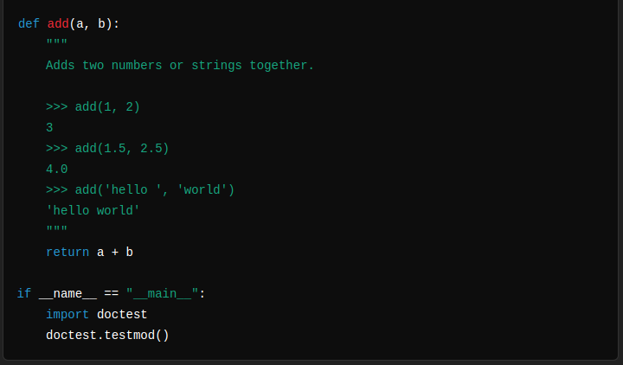
Doctest
the doctest module in Python allows you to write tests as part of your docstrings (documentation strings). This can be useful for testing small code snippets . There are several common ways to use doctest:
To check that a module’s docstrings are up-to-date by verifying that all interactive examples still work as documented.
To perform regression testing by verifying that interactive examples from a test file or a test object work as expected.
To write tutorial documentation for a package, liberally illustrated with input-output examples. Depending on whether the examples or the expository text are emphasized, this has the flavor of “literate testing” or “executable documentation”.

Slide 14
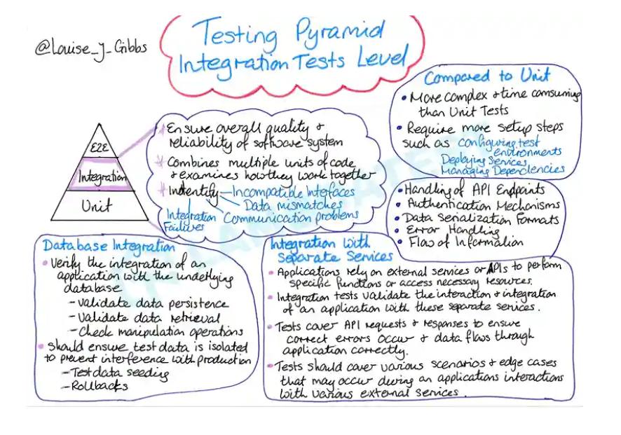
Integration Testing
Integration testing is the crucial second stage of software testing, assessing how individual components collaborate to ensure proper functioning and identify defects within a software project. As the second level of software testing, integration testing ensures components harmonize flawlessly.
Initially, software testing was not dependent on integration testing, and nobody had ever thought about building an advanced testing phase with the capability of finding issues during the development process. But with the growing digital sphere, the demand for integration testing has increased.
Selenium: Selenium is the leading large-scale open-source test automation framework to automate integration test suites for your web applications.You can also use unittest and pytest for this.

Slide 15
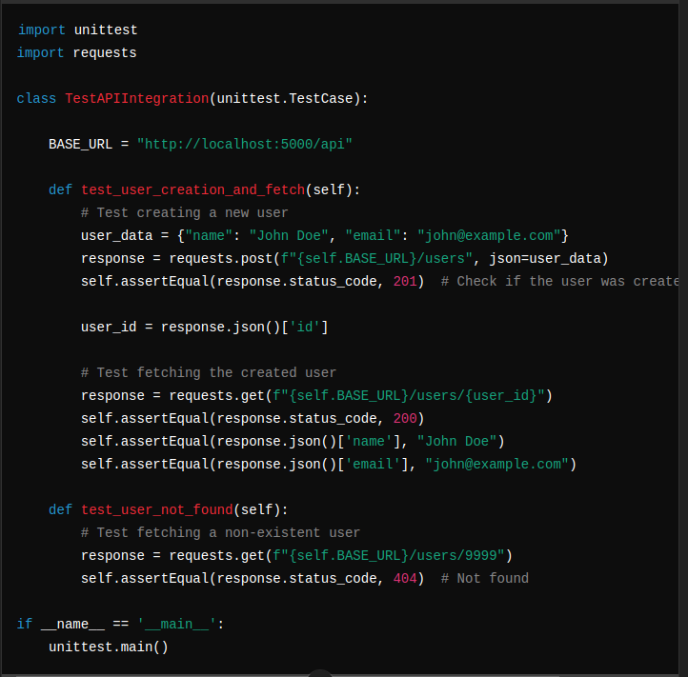
Example of Integration Testing
Let's assume you have a web application with a RESTful API, and you want to perform integration testing on it.
This script defines two integration tests for a RESTful API:
test_user_creation_and_fetch: Tests that a user can be created and then retrieved successfully.
test_user_not_found: Tests that the API correctly returns a 404 error when attempting to retrieve a non-existent user.
These tests help ensure that different parts of the API work correctly together, such as user creation, data retrieval, and error handling.

Slide 16
System Testing
System testing is a level of software testing where the complete and integrated software system is tested as a whole. The purpose of system testing is to validate the end-to-end functionality of the system as it would be used in a production environment. This type of testing ensures that the system meets its specified requirements and behaves as expected in real-world scenarios.
Key points about system testing:
Objective: To verify that the system meets the specified requirements and to validate its behavior in a fully integrated environment.
Scope: System testing involves testing the entire application, including hardware, software, network, and integration points.
Black-box Testing: Typically, system testing is considered a form of black-box testing, where the internal workings of the application are not known to the tester.
Types of System Testing: This can include functional testing, performance testing, security testing, usability testing, and more

Slide 17
Stages of System Testing
Typically, system testing goes through the following stages:
Test environment. In this initial stage, a test server is set up for creating a testing environment, which enables a tester to run a set of predefined test cases and test scripts.
Test case. This stage generates the test case for the testing process.
Test data. At this stage, the data to be tested is generated.
Test case execution. Once the test case and test data are generated, test cases are executed.
Reporting of defects. This is the stage where defects in the system are identified.
Regression testing. This is done to see if any problems were introduced into the development process by the previous stages.
Defect logging. All the identified defects are fixed at this stage.
Retest. A test is repeated if it's unsuccessful.

Slide 18
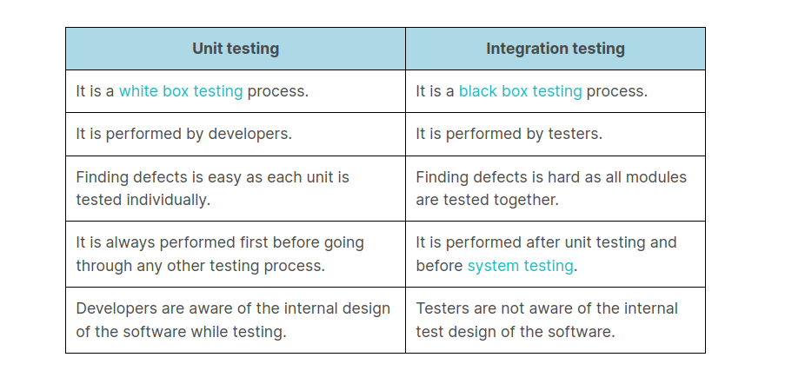
Difference between Unit testing and Integration testing

Slide 19
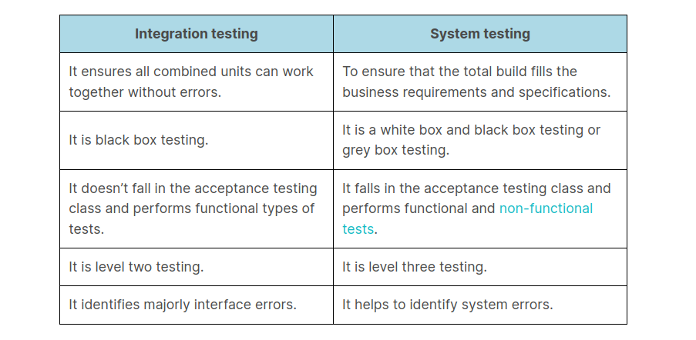
Difference between Integration testing and System testing

Slide 20
Test Coverage
Test coverage is a metric used in software testing to measure the amount of code that is exercised by tests. It provides insights into how much of the application’s codebase is tested by the test suite, helping to identify untested parts of the code. The goal of test coverage is to ensure that the code is sufficiently tested, thereby reducing the risk of defects in the software.
Key Points about Test Coverage:
Types of Coverage:
Line Coverage: Measures the percentage of lines of code executed during testing.
Branch Coverage: Measures whether each possible branch (e.g., if/else statements) was taken.
Function Coverage: Measures the percentage of functions or methods that have been called.
Condition Coverage: Measures whether each boolean sub-expression evaluated to both true and false.

Slide 21
Test Coverage in Python
Python provides several tools to measure test coverage, the most popular being coverage.py. This tool can be used in conjunction with testing frameworks like unittest, pytest, or nose to measure how much of your code is covered by tests.
Using coverage.py
coverage.py is a powerful tool for measuring code coverage in Python. Here’s how to use it:
Installation: Install coverage.py using pip: pip install coverage
To measure the coverage while running your tests, you can use the coverage run command: coverage run -m unittest discover.
After running the tests, generate a coverage report: coverage report
For a more detailed analysis, generate an HTML report: coverage html

Slide 22
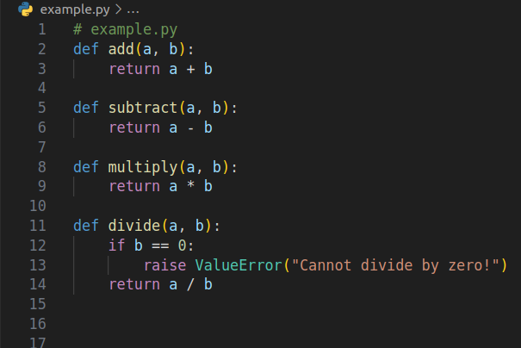
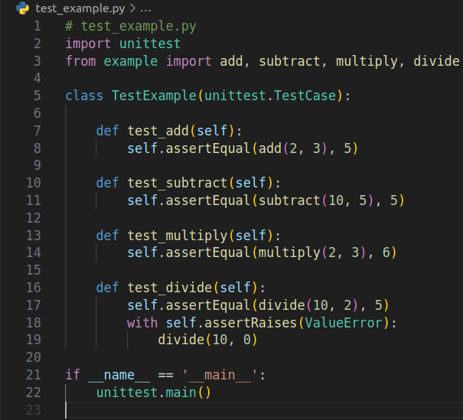
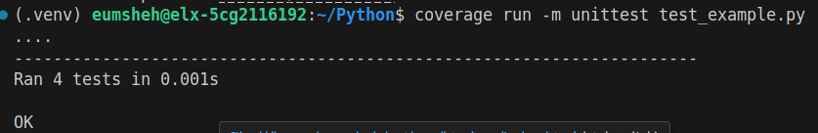
Example of Test Coverage:
Create a example.py
Create a test_example.py

Slide 23
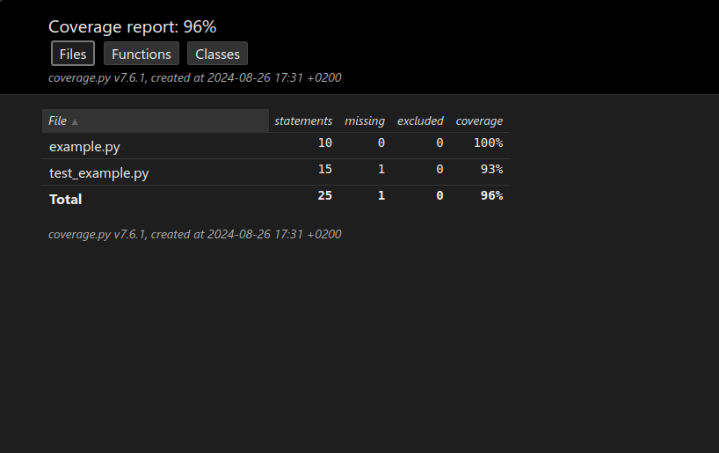
Run coverage html to view the result over the browser:

Slide 24
See you in the Lab ☺

